Slide 1

PROJECT BASED LEARNING
GROUP-2

Slide 2
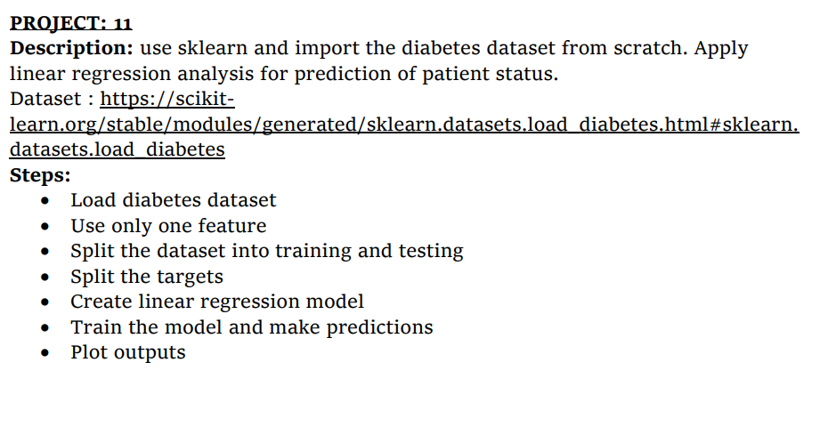
PROJECT-11

Slide 3
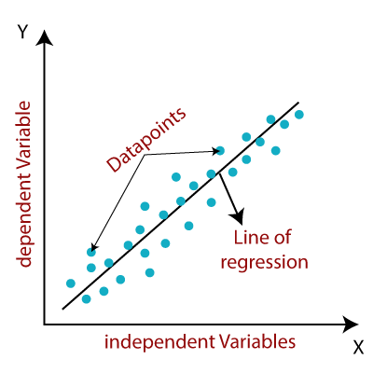
LINEAR REGRESSION:
The term “linearity” in algebra refers to a linear relationship between two or more variables. If we draw this relationship in a two dimensional space (between two variables), we get a straight line
Linear regression performs the task to predict a dependent variable value (y) based on a given independent variable (x).
• Y = m * X + C

Slide 4
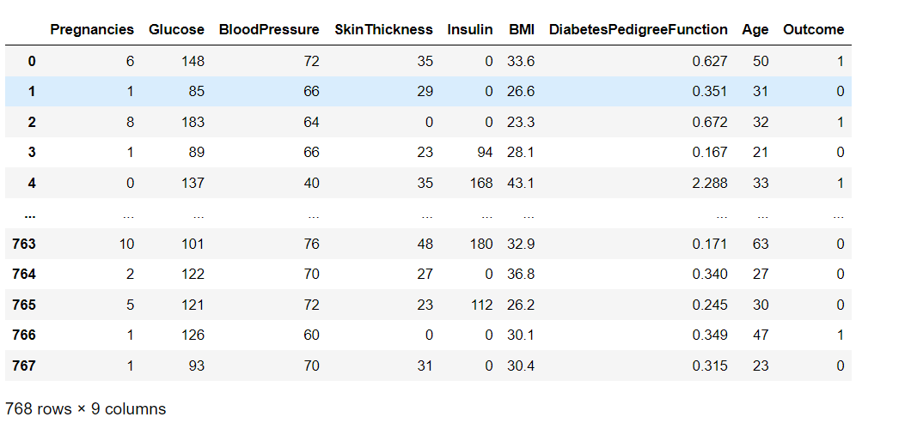
DATA SET USED:
Dataset : https://scikitlearn.org/stable/modules/generated/sklearn.datasets.load_diabetes.html#sklearn. datasets.load_diabetes
Diabetes Dataset

Slide 5
Libraries used:
Pandas
Numpy
Sklearn
Mathplotlib

Slide 6
Step-1: Load diabetes dataset
from sklearn.datasets import load_diabetes
df = load_diabetes()
df

Slide 7
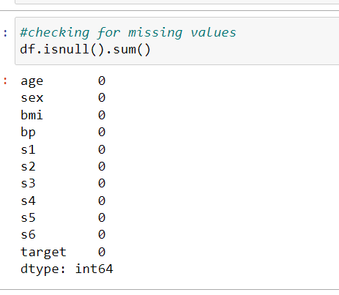
df.head() #head is used to get first 5 rows
df.info() #used to print summary of a dataset
df.shape #to get the shape of the dataset
df.columns #to know what columns are there in dataset
df.dtypes #used to find the dtypes in the dataframe
df= df.drop_duplicates() #drop_duplicates() helps in removing duplicates from the data frame
df.isnull().sum() #checking for missing values
As there are no missing values we can continue
With the process

Slide 8
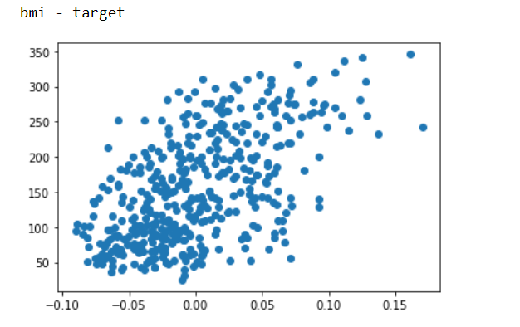
Step-2: Use only one feature
To choose which feature should be used we used correlation function and plotted the scatter plot
df.corr()
import matplotlib.pyplot as plt
%matplotlib inline
q = list(df.columns)
q.pop()
for i in q:
print(i+' -'+' target')
plt.scatter(df[i],df['target'])
plt.show()

Slide 9
#Using 1 feature
# correlation between bmi and target is 0.586
# chose bmi as independent variable (x)
# target as dependent variable (y)
x=df.drop(columns=['sex','age','bp','s1','s2','s3','s4','s5','s6','target'])
y = df['target']
so dropped remaining all features except bmi as we selected bmi as our independent variable

Slide 10
Step-3: Split the dataset into training and testing
For this we imported train_test_split from sklearn.model_selection
from sklearn.model_selection import train_test_split
import numpy as np
x_train,x_test,y_train,y_test = train_test_split(x,y,test_size = 0.2)
print(x_train.shape)
print(x_test.shape)

Slide 11
#Step : 4,5
#Create Linear regression model
To create linear regression model we imported linearregression from sklearn.linear_model
from sklearn.linear_model import LinearRegression
clf = LinearRegression()
clf.fit(x_train,y_train)

Slide 12

#STEP-6: Train the model and make predictions
In this we made the predictions
#Step : 6
#train the model and making predictions
print('testing - ',clf.score(x_test,y_test))
print('training - ',clf.score(x_train,y_train))
Here we got training accuracy as 0.31514 and testing accuracy as 0.349411
Because we selected only one feature and trained and tested the data based on only one feature so we got less test and train accuracy

Slide 13
#step-8: Plot outputs
Here we plotted the linear regression graph and we got a straight line for the target variable
import matplotlib.pyplot as plt
X = df.iloc[:, 0].values.reshape(-1, 1)
Y = df.iloc[:, 1].values.reshape(-1, 1)
linear_regressor = LinearRegression()
linear_regressor.fit(X, Y)
Y_pred = linear_regressor.predict(X)
plt.scatter(X,Y, color='red', label='X')
plt.plot(X, Y_pred, color='green', label='Y_pred', marker='+', markersize=14)
plt.legend(title="Linear Regression Model")

Slide 14
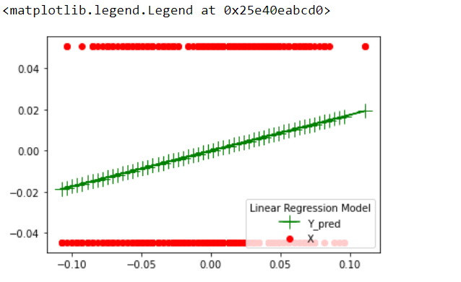
Plotted graph:

Slide 15


